Slide 1
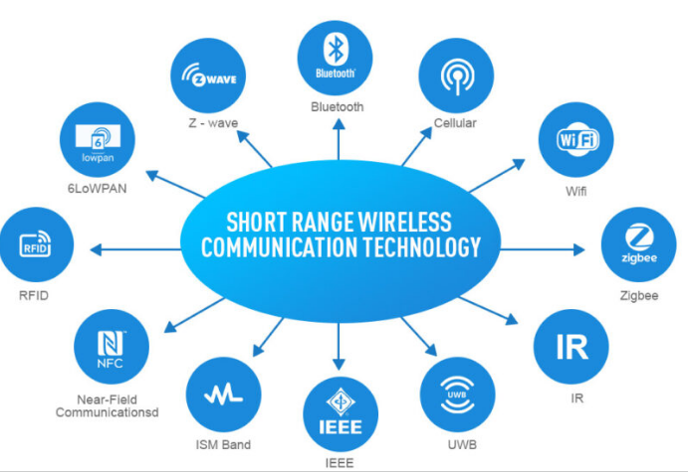
21ECO101T
SHORT RANGE WIRELESS COMMUNICATION

Slide 2
Unit-1: Wireless systems
Unit-2: Antenna and Baseband coding basics
Unit-3: RF transceivers
Unit-4: Wireless standards
Unit-5: Optical wireless technologies
Alan Bensky, “Short range Wireless Communications- Fundamentals of RF system design and Applications”, Elsevier Inc, 2004
2. Antti V. Raisanen, Arto Lehto, “Radio engineering for wireless communication and sensor applications”, Artech House, 2003
3. Rolf Kraemer and Marcos Katz, “Short-range wireless communications emerging technologies and applications”, Wiley WWRF series, March 2009
4. Shlomi Arnon, John Barry, George Karagiannidis, Robert Schober, Murat Uysal, “Advanced Optical Wireless Communication Systems” , Cambridge University Press, 2012

Slide 3
Unit-1 - Wireless Systems
Introduction to wireless systems
Reasons for the Spread of Wireless Applications
Characteristics of Short-range Radio Wireless Applications
Elements of Wireless Communication Systems - Transmitter
Elements of Wireless Communication Systems - Receiver
Wireless Local Area Networks (WLAN),
WIFI Network Architecture
Bluetooth, Transceiver, Bluetooth Modes
Zigbee Architecture, Frame Structure Applications
Conflicts, Ultra-wideband Technology, Bit Sequence detection, UWB Block Diagram

Slide 4
Introduction to Wireless Systems
A wireless system refers to a network or communication system that transmits and receives data or information without the use of physical cables or wired connections.
It utilizes electromagnetic waves or radio frequencies to transmit signals between devices, allowing for convenient and flexible communication and connectivity.
Wireless systems have become an integral part of modern life, enabling various technologies such as mobile phones, Wi-Fi networks, Bluetooth devices, wireless sensors, and many other applications.
These systems have revolutionized the way we communicate, access information, and interact with our environment.

Slide 5
Types of Wireless Communication
Mobile
Cellular Phones (GSM( Global System for Mobile)/ CDMA(Code Division Multiple Access))
Portable
IEEE 802.11b (Wi-Fi-Wireless Fidelity)
IEEE 802.15.3 (UWB-Ultra-Wideband)
Fixed
IEEE 802.16 (Wireless Metropolitan Area Network-WMAN)
*GSM- describe the protocols for second-generation digital cellular networks used by mobile devices such as mobile phones and tablets.
*CDMA-method of encoding several sources of data so they may all be transmitted over a single RF carrier by one transmitter, or by using a single RF carrier frequency with multiple transmitters.

Slide 6
Typical Frequencies
FM Radio ~ 88 MHz
TV Broadcast ~ 200 MHz
GSM Phones ~ 900 MHz
GPS ~ 1.2 GHz
Bluetooth ~ 2.4 GHz
WiFi ~ 2.4 GHz

Slide 7
Why Wireless?
Benefits
Mobility: Ability to communicate anywhere!!
Easier configuration, set up and lower installation cost
Difficulties
Communication medium: Free space
Noisy and unpredictable channel
Broadcast channel, more user ->less BW per user
Higher equipment cost
Usually regulated spectrum and limited BW
Need backbone systems in order to function properly

Slide 8
Challenges
Efficient Hardware
Low power transmitters, receivers
Low power signal processing tools
Efficient use of finite radio spectrum
Cellular frequency reuse, medium access control (MAC) protocols
Integrated Services
Voice, data, multimedia over the same network
Service differentiation, priorities, resource sharing
Network support for user mobility (mobile scenarios)
Location identification, Handoffs,..
Maintaining quality of service over unreliable links.
Connectivity and coverage (internetworking)
Cost efficiency

Slide 9
Overview
Short-range wireless communications typically refers to a wide variety of technologies with communication ranges from a few centimeters to several hundreds of meters.
While the last three decades of the wireless industry have been mostly dominated by cellular systems, short-range wireless devices have gradually become a more integrated part of our everyday lives over the last decade.
The majority of these devices will be short-range wireless devices that interconnect people with each other and their environments.

Slide 10
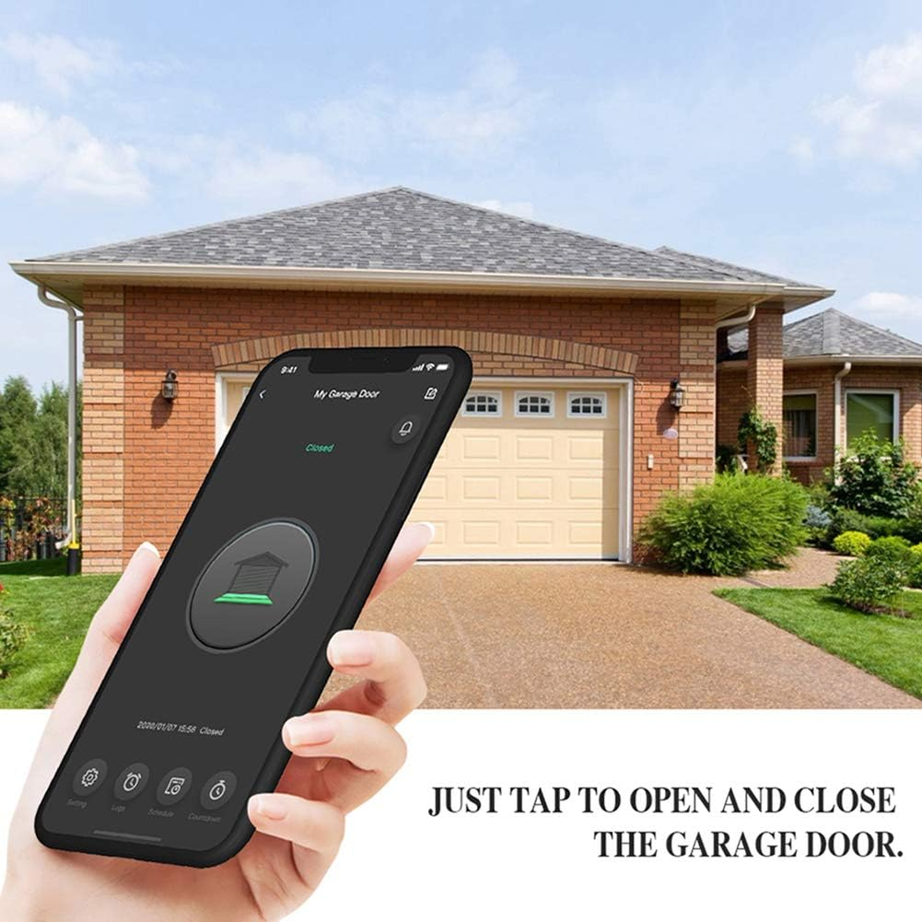

Slide 11
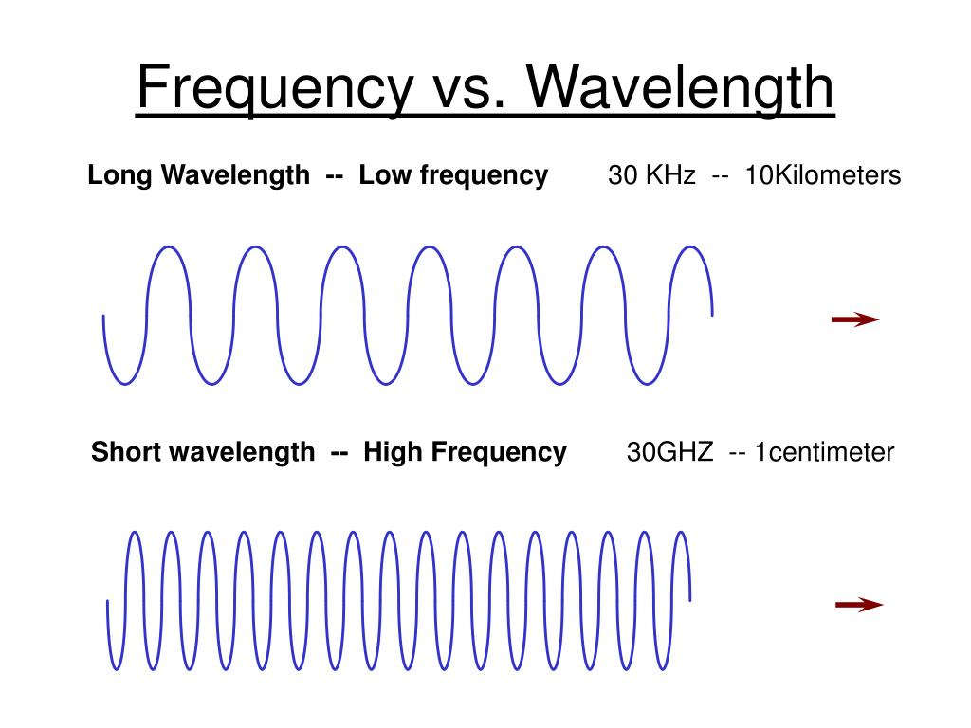

Slide 12
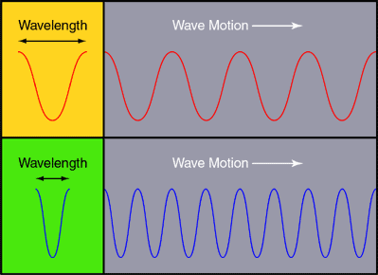

Slide 13
Reasons for spread of Wireless Applications
Employment of higher and higher frequencies in spectrum which was expensive previously
SSD (solid state devices) amplify at mm(millimeter) wavelengths or 10’s of GHz
Efficient and compact antennas (planar antennas) are available used in short-range devices.
Development of SAW(Surface Acoustic Wave) frequency determining components allows generation of UHF with very simple circuits
Digital modulation techniques permits multiplication of number of communication channels
Progress in circuit miniaturization →Hybrid IC (integrated circuits) combining analog and digital functions on one chip and RFIC (radio frequency IC) responsible for compact size of cellular handsets.

Slide 14
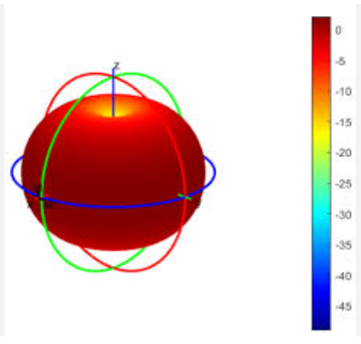
Characteristic of Short Range Radio
RF output → several microWatts up to 100 milliWatts
Communication range →several cm up to several 100 m
Indoor operation
Omnidirectional built-in antennas
Simple construction and low price → consumer applications
Unlicensed operation
Non critical bandwidth specifications
UHF operation
Battery operated Tx/Rx
Omnidirectional antenna which radiates equal radio power in all directions perpendicular to an axis, with power varying with angle to the axis,

Slide 15
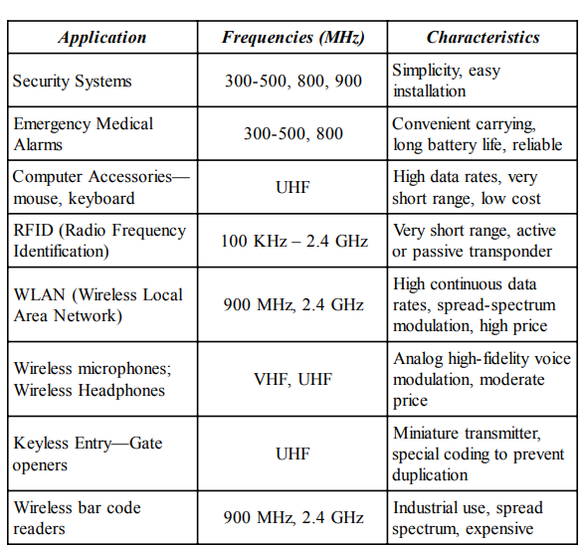



Short range radio applications

Slide 16
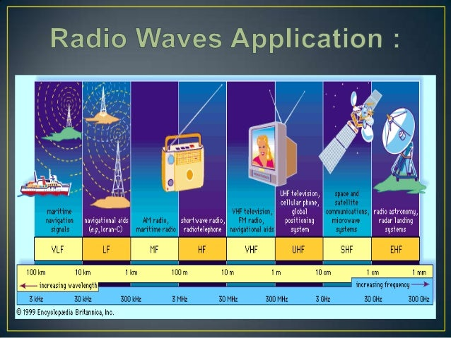

Slide 17
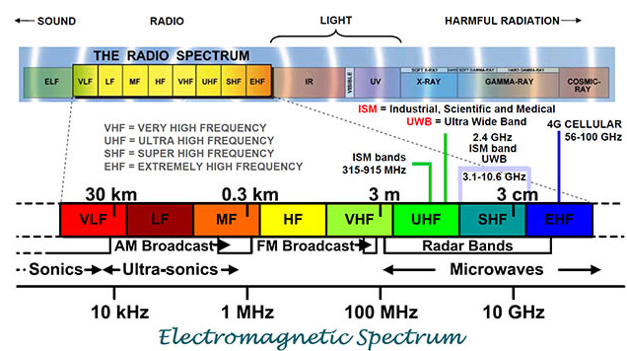

Slide 18
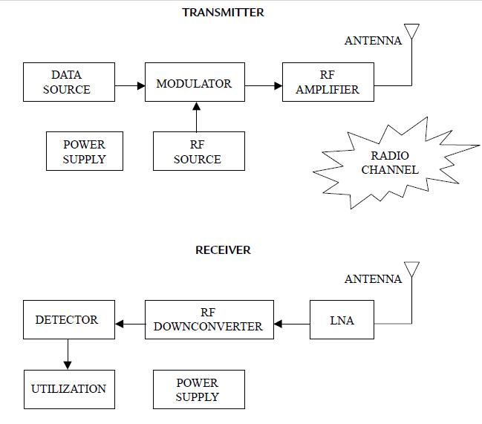
Elements of Wireless Communication Systems
Data source
RF generating section
RF conduction and radiation
Radio channel
Receivers
Power supply

Slide 19
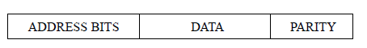
Elements of Wireless Communication Systems
Data source:
Analog/ Digital
Simple on/off info →security intrusion detector, panic button, manual remote control unit
Change of state of data cause message frame modulated on RF carrier
Address field → identifies unit that is transmitting
Data field →conveys specific info (on/off form)
Parity bit → detect false messages
Computer accessories and WLAN send continuous digital data over short –range link
Data are organized →protocol including sophisticated error detection and correction technique
Audio devices →wireless microphone and headsets send analog data to modulator.
These data specially processed for better pefromance over wireless channel

Slide 20
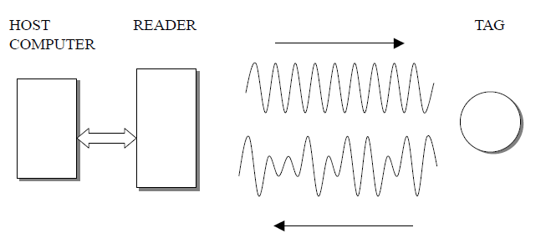
Elements of Wireless Communication Systems-Data source-cont…
FM transmission: pre-emphasis filter increases HF before Txion
Receiver : De-emphasis filter will also reduce HF noise
Dynamic range is increased by use of compander
Txer: weak sounds are amplified more and strong signals are amplified less
Rxer: Opposite procedure reduces background noise while retaining weak sounds to their proper relative level
RFID: different aspect of data source
Data not available in Txer but added to RF signal in an intermediate receptor called Transducer ( may be active/passive)
Txed RF is modified by transducer and detected by Rxer that deciphers data added and passes to host computer
COMPANDER:
combination of a COMPressor and an exPANDer.

Slide 21
Elements of Wireless Communication Systems
2. Radio frequency (RF) generating section:
Part of Txer consists of RF source (oscillator), modulator, and amplifier.
Simplest short range devices → all 3 functions included in a single circuit of only one transistor.
RFID is different from other applications→ modulation is carried out remotely from RF source
3. RF conduction and radiation:
Built-in antennas →transmission lines are relatively short & simple
Antennas of short range devices must be small→ fraction of wavelength and omnidirectional mostly

Slide 22
Elements of Wireless Communication Systems
4. Radio channel
Range of the channel is short and equipment is used indoors
RF power is relatively low and regulated by telecom authorities
Devices often operated close to or attached to human body→affects communication performance
Reliable operating range difficult to predict
Lack of knowledge of special propagation characteristics by manufactures, sellers and users → dominant reason for unreliability
Short range devices often used to replace hard wiring→ when similar performance is expected, limitations of radio propagation compared to wires must be accounted for each application

Slide 23
5. Receivers
Similar blocks like Txer but operation is reversed→ antenna, Txion line, RF amplifiers and oscillators
Weak signals that are intercepted by antenna are amplified above the circuit noise by low noise amplifier(LNA)
Desired signal is separated from all others and shifted lower in frequency in downconverter→ more effectively amplified to level required for demodulation or detection.
Demodulator→ conversion of data source implanted on RF wave in Txer back to original form
Txer power is limited by authorities, Rxer sensitivity is not
To improve system performance→ improve sensitivity and selectivity→ to reduce interference from unwanted sources→ must be done under constraints of physics, cost, size and power consumption

Slide 24
Elements of Wireless Communication Systems-Rxer-cont…
Important factor in LP system design and controversial one→ type of modulation
Simpler systems→ security and medical alarms →choice is between amplitude shift keying (ASK), parallel to amplitude modulation (AM) in analog system and frequency shift keying (FSK) analogous to frequency modulation (FM)
Downconverter takes a radio frequency (RF) signal and converts it to a lower, intermediate frequency (IF) signal that is suitable for digital processing.
Selectivity is the ability of radio receiver to reject signals close to desired frequency.
Sensitivity of a radio receiver is its ability to amplify the desired weak signal.

Slide 25
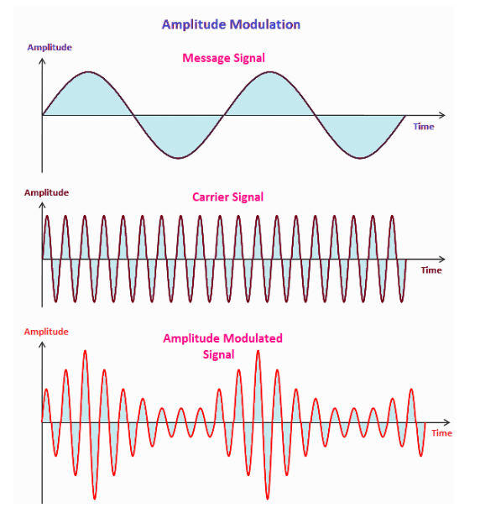
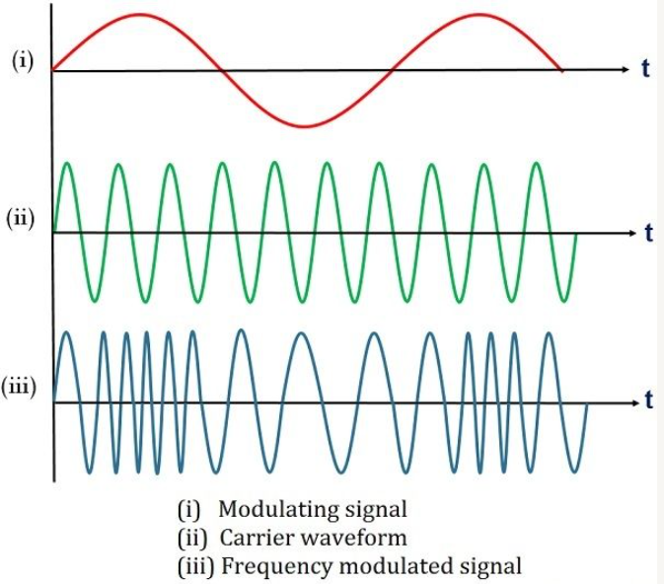
AM and FM
AM and FM modulation video link
https://www.youtube.com/watch?v=QEubAxBfqKU

Slide 26
Elements of Wireless Communication Systems-Power supply
6. Power supply
Short range devices, atleast one side of wireless link must be completely untethered( unattached to any data or power source by wire or fiber)
When size limited, in hand-operated remote control Txers and security detectors, battery size and energy is limited
Need to change batteries not only highly inconvenient but also expensive
Low current consumption is important design aim for wireless devices → harder to achieve for Rxer than Txers
Many short range app. → intermittent Txer operation …
Eg. security systems : Txers → kept in very low current sandby status until data needs to be send.. …Rxer → doesn’t know when data will be sent → must be alert all the time
Techniques to reduce Rxer duty cycle→ doesn’t draw full current all time
Another way for reducing Rxer power consumption→ to operate in reduced power standby mode, operation goes to normal when beginning of signal is detected→ reduced sensitivity

Slide 27
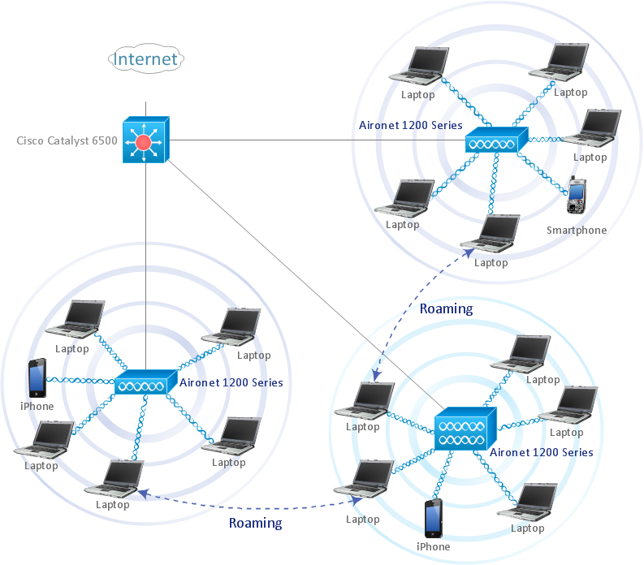
Wireless Local Area Networks (WLAN)

Slide 28
WLAN- Introduction
One of the hottest applications of short-range radio communication is wireless local area networks.
The early versions of WLAN had considerably inferior data rates.
However, advanced modulation techniques have allowed wireless throughputs to approach and even exceed those of wired networks
The popularity of highly portable laptop and handheld computers, along with the decrease in device prices, have made computer networking a common occurrence in multi-computer offices and homes.

Slide 29
WLAN- cntd…
Three prime disadvantages to wireless networks as compared to wired:
Range limitation
Susceptibility to electro magnetic interference
Security
The Home RF Working Group- uses SWAP (Shared Wireless Access Protocol)
Wi-Fi - Wi-Fi is the generic name for all devices based on the IEEE specification 802.11 and its derivatives.

Slide 30
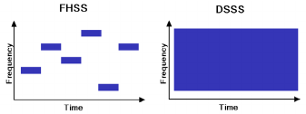
Wi –Fi - Wireless Fidelity
802.11 is the predominant industrial standard for WLAN
Products adhering to it are acceptable for marketing all over the world.
802.11 covers the data link layer of lower-level software, the physical layer hardware definitions, and the interfaces between them.
The connection between application software and the wireless hardware is the MAC(medium access control).
The basic specification defines three types of wireless communication techniques: DSSS (direct sequence spread spectrum), FSSS (frequency-hopping spread spectrum) and IR (infra-red).
The specification is built so that the upper application software doesn’t have to know what wireless technique is being used—the MAC interface firmware takes care of that.

Slide 31
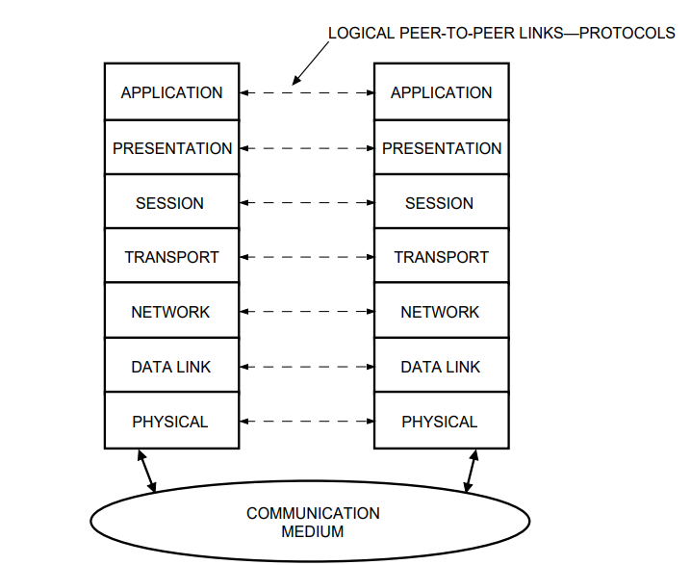
Open System Interconnection Reference Model

Slide 32
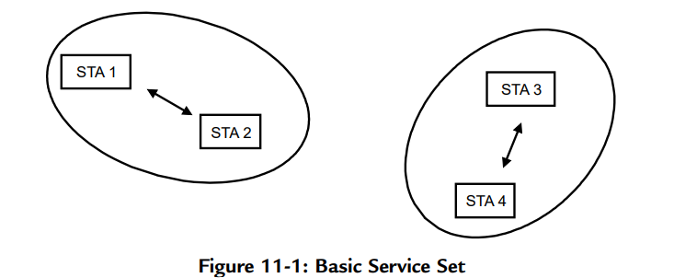
Wi –Fi – Network Architecture
Three Wi-Fi network configurations are available.
Fig. 11.1 shows two unattached basic service sets (BSS), each with two stations (STA).
The BSS is the basic building block of an 802.11 WLAN. A station can make adhoc connections with other stations within its wireless communication range but not with those in another BSS that is outside of this range.
In order to interconnect terminals that are not in direct range one with the other, the distributed system shown in Fig. 11.2 is needed.

Slide 33
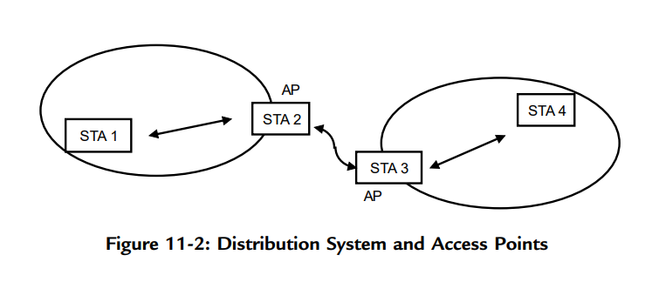
Wi –Fi
Here, terminals that are in range of a station designated as an AP can communicate with other terminals not in direct range but who are associated with the same or another AP.
Two or more such APs communicate between themselves either by a wireless or wired medium, and therefore data exchange between all terminals in the network is supported.
Important thing →medium connecting the STAs with the APs, and that, connecting the APs among themselves are totally independent.

Slide 34
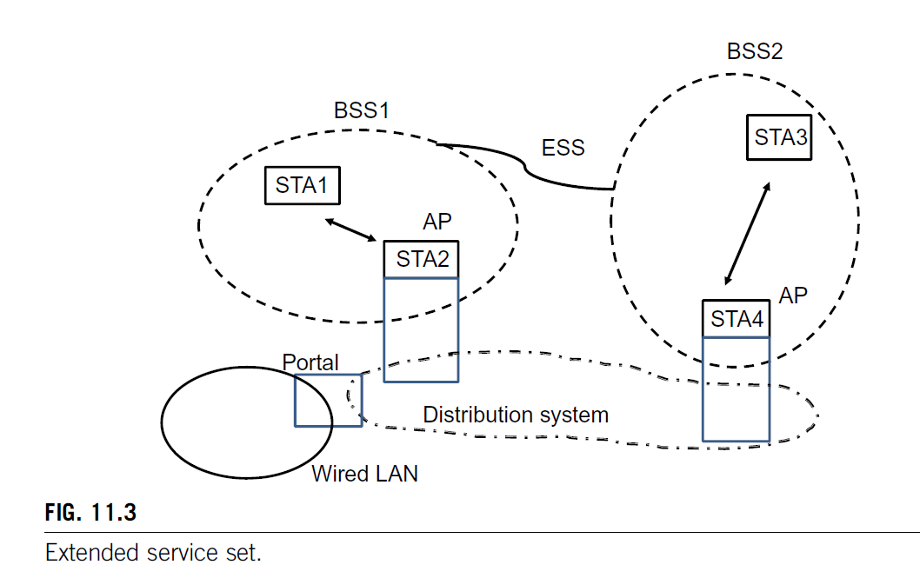
Wi –Fi
STA is an addressable destination, not necessarily at a fixed location. STA’s may have varied characteristics and functions.
A STA →AP terminal, a mobile terminal, or it may have another specified function.
A network of arbitrary size and complexity can be maintained through the architecture of the extended service set (ESS), shown in Fig. 11.3.
STAs have full mobility and may move from one BSS to another while remaining in the network.

Slide 35
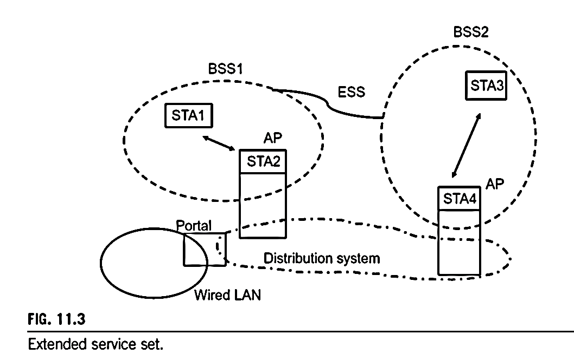

Slide 36
Wireless Local Area Networks (WLAN)
Fig. 11.3 shows another element type—a portal. The portal is a gateway between the WLAN and a wired LAN.
It connects the medium over which the APs communicate to the medium of the wired LAN—coaxial cable or twisted pair lines.
In addition to the functions Wi-Fi provides for distributing data throughout the network, two other important services, although optionally used, are provided.
They are authentication and encryption.
Authentication is the procedure used to establish the identity of a station as a member of the set of stations authorized to associate with another station.
Encryption applies coding to data to prevent an eavesdropper from intercepting it.
802.11 details the implementation of these services in the MAC(Media Access Control).
Further protection of confidentiality →provided by higher software layers in the network that are not part of 802.11.

Slide 37
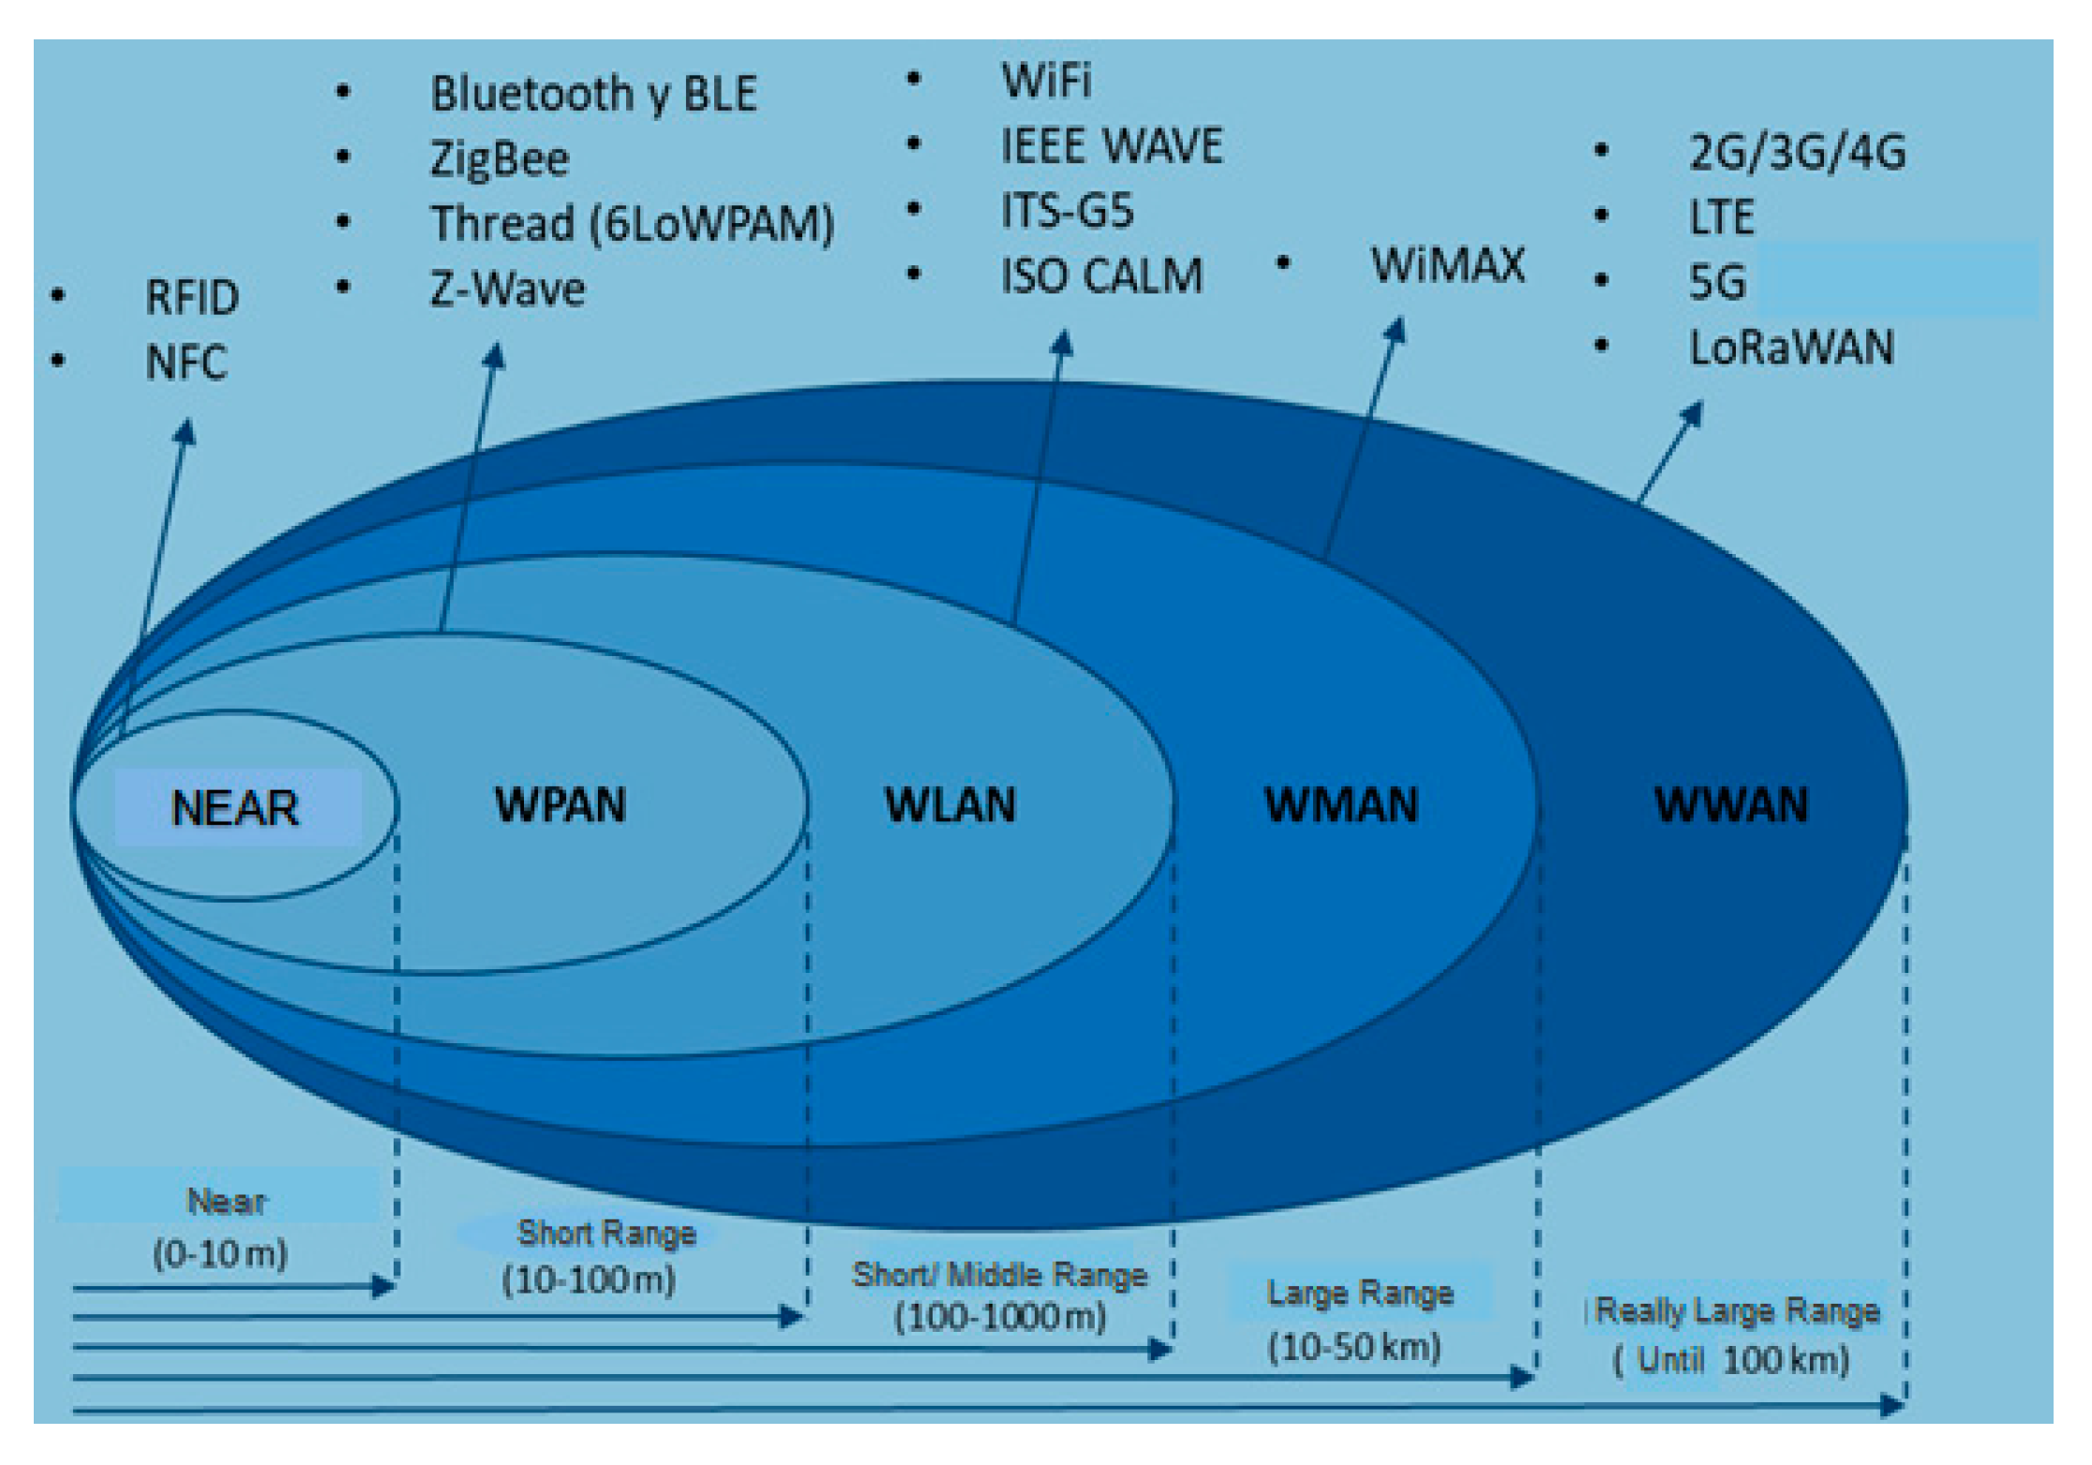

Slide 38
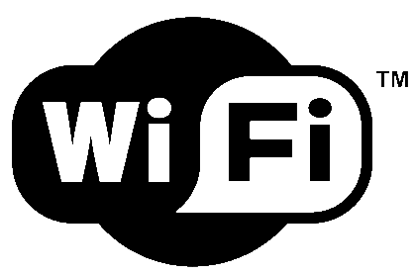
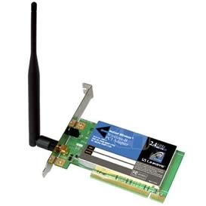
Wireless Fidelity Wi-Fi
IEEE 802.11g
Data Rate: Maximum 54 Mbps
Range: up to 100 meters
Operating Frequency: 2.4 GHz
Security: Password Encryption
How It works?
Data Transmission/Acquisition
Wired Ethernet connection
OFDM
Closely spaced orthogonal sub-carriers.
Reduction of attenuation with high frequencies.
Facilitates single-frequency networking.
Broadcasting
Decoding of the Signal
Wireless Card
In telecommunications, orthogonal frequency-division multiplexing is a type of digital transmission used in digital modulation for encoding digital data on multiple carrier frequencies.
WiFi :https://www.youtube.com/watch?v=St0V1yYxpv4

Slide 39
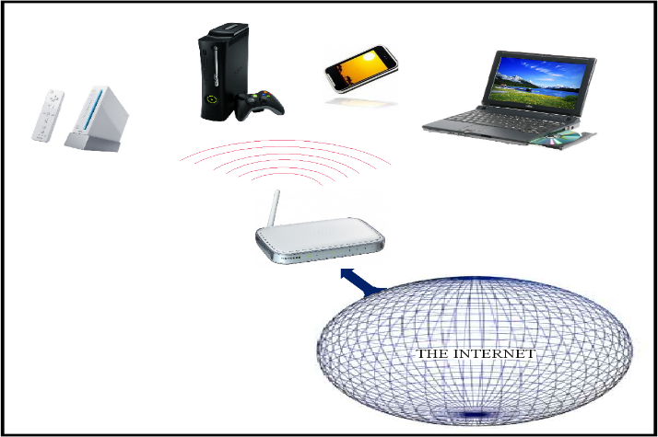
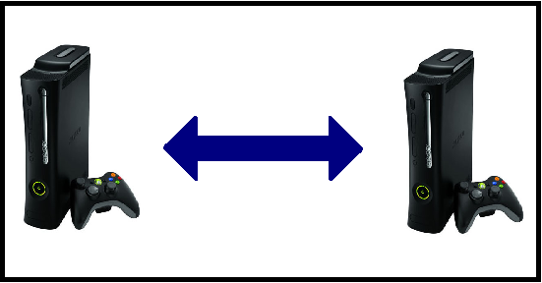
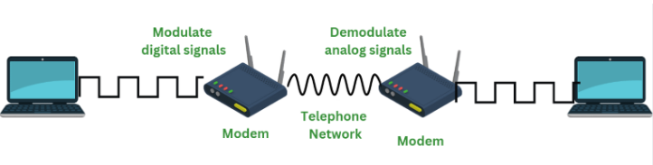
Wi-Fi
Applications
Modem for internet
Cable
DSL
Device to device communication
Advantages:
Comparatively higher data transfer rates than other similar technologies.
Low infrastructure
Wide availability
Disadvantages:
Cost
Limited range: Restricted to “Hot Spots”
DSL(Digital subscriber line)used to transmit digital data over telephone lines.

Slide 40
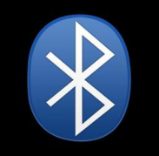

Bluetooth
Open Wireless Protocol, WPAN standard
Operates ISM (industrial, scientific, and medical) band at 2.4-2.4835 GHz
Uses radio technology called frequency- hopping spread spectrum (FHSS)
Modulation - Gaussian Frequency-Shift Key Modulation
Frequency- Hopping Spread Spectrum
Chunks of data transmitted
Spread-spectrum signals are highly resistant to narrowband interference
Difficult to intercept
Transmissions share a frequency band with minimal interference
Bluetooth: https://www.youtube.com/watch?v=jzxZUJmOu3o
Notes:
RS232 is recommended standard for serial binary data commonly used for computer serial ports
40

Slide 41
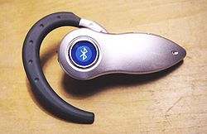
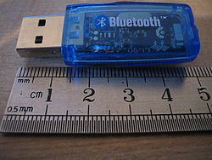
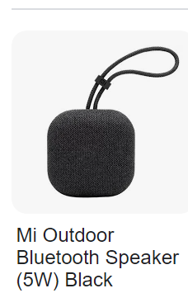
Bluetooth
Data rate up to 1Mb/s – 3 Mb/s
Use in mobile phones, laptops, telephones, printers, GPS, video game consoles
Bluetooth USB dongle – must use if computer is not Bluetooth enabled
Advantages:
Wireless, Inexpensive, Automatic
Low energy and power consumption
Disadvantages:
Security
Viruses over the years
Bluejacking
Health Concerns (same as mobile phones)
Bluejacking is when an attacker sends unsolicited messages to a victim's Bluetooth-enabled device.
Notes:
RS232 is recommended standard for serial binary data commonly used for computer serial ports
41

Slide 42
Bluetooth Architecture
Bluetooth is an example of a WPAN. (wireless personal area networks (WPAN), which typically serve a communication range of 10 m).
It’s based on the creation of ad hoc, or temporary, on-the-fly connections between digital devices associated with an individual person and located in the vicinity of around 10 m from him.
Bluetooth devices in a network have the function of a master or a slave, and all communication is between a master and one or more slaves, never directly between slaves.
The basic Bluetooth network is called a piconet. It has one master and one to seven slaves.
A scatternet is an interrelated network of piconets where any member of a piconet may also belong to an adjacent piconet.
Conceptually, a Bluetooth network is infinitely expandable.

Slide 43
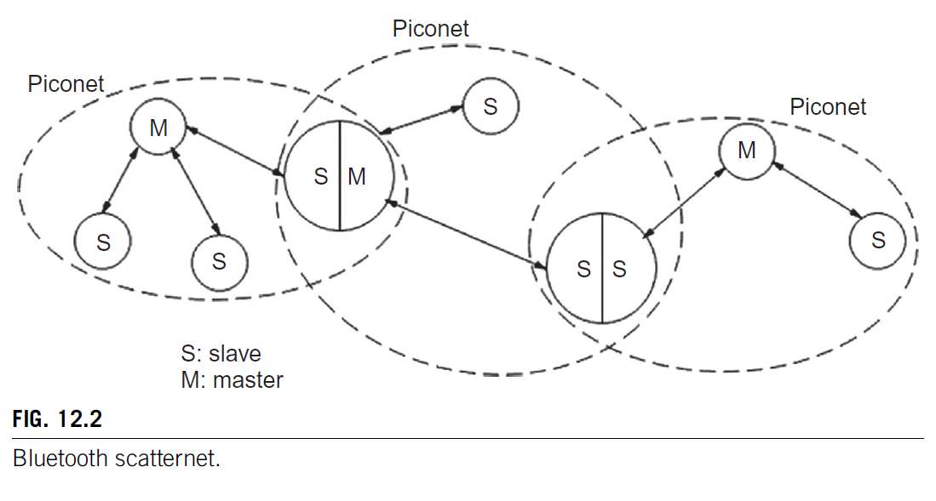
Bluetooth Architecture
Fig. 12.2 shows a scatternet made up of three piconets.
A node may be a slave in one piconet and a master in another.
A device may be a master in one piconet only.

Slide 44
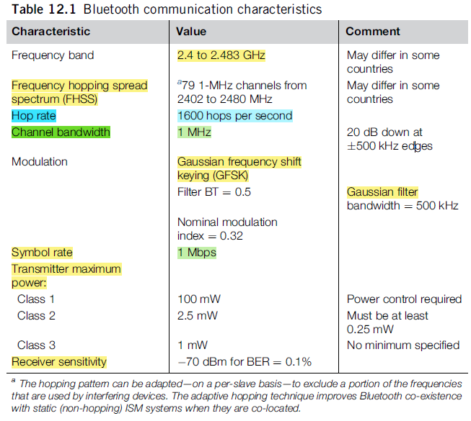

Slide 45
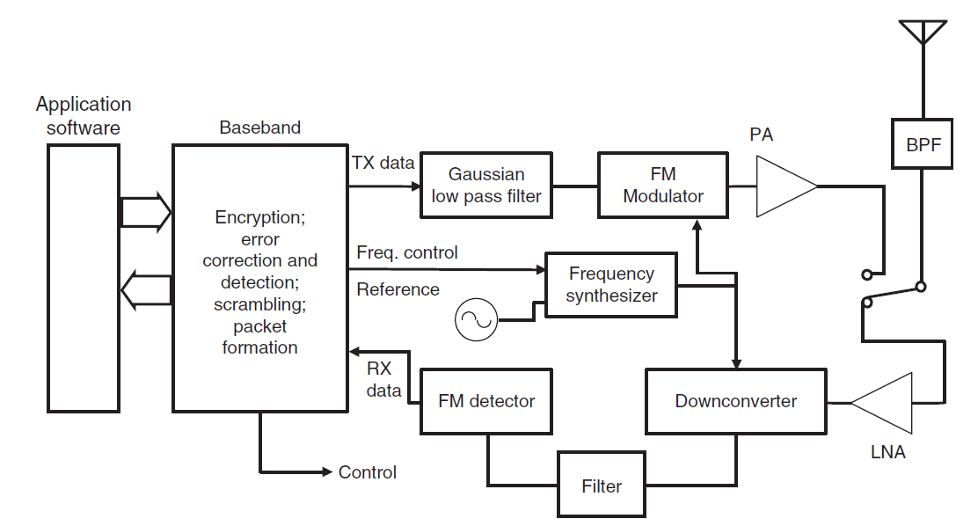
Bluetooth Transceiver
Three basic parts: RF, baseband, and application software
A Bluetooth chip set will usually include the RF and baseband parts, with the application software being contained in the system’s computer or controller.

Slide 46
Bluetooth Transceiver
The user data stream originates and terminates in the application software.
The baseband section manipulates the data and forms frames or data bursts for transmission. It also controls the frequency synthesizer according to the Bluetooth frequency-hopping protocol.
The Gaussian low-pass filter block before the modulator → implemented digitally as part of a complex signal I/Q modulation unit or it may be a discrete element
Receiver may be one of several types.
If a superheterodyne configuration is chosen, the filter at the output of the down converter will be a bandpass type.
A direct conversion receiver will use low pass filters in complex I and Q outputs of the down converter.
IQ modulation
https://www.youtube.com/watch?v=zNbWTiKEl30

Slide 47
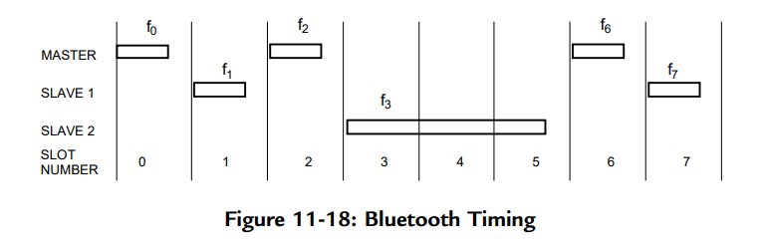
Bluetooth Timing
The Bluetooth protocol has a fixed-time slot of 625 microseconds.
A transmission burst may occur within a duration of one, three, or five consecutive slots on one hop channel.
Transmissions are always between the piconet master and a slave, or several slaves.
Typically, a single-slot transmission burst lasts 366 microseconds, leaving 259 microseconds for changing the frequency of the synthesizer

Slide 48
Bluetooth modes
Bluetooth has three modes for achieving different degrees of power consumption during operation: sniff, hold, and park.
Even in the normal active mode, some power saving can be achieved.
Active mode:
During normal operation, a slave can transmit in a particular time slot only if it is specifically addressed by the master in the proceeding slot.
As soon as it sees that its address is not contained in the header of the master’s message, it can “go to sleep,” or enter a low-power state until it’s time for the next master transmission.
The master also indicates the length of its transmission (one, three, or five slots) in its message header, so the slave can extend its sleep time during a multiple slot interval

Slide 49
Bluetooth modes
Sniff mode:
In this mode, sleep time is increased because the slave knows in advance the time interval between slots during which the master may address the slave.
If it’s not addressed during the agreed slot, it returns to its low-power state for the same period and then wakes up and listens again.
When it is addressed, the slave continues listening during subsequent master transmission slots as long as it is addressed, or for an agreed time-out period.

Slide 50
Bluetooth modes
Hold mode:
The master can put a slave in the hold mode when data transfer between them is being suspended for a given period of time.
The slave is then free to enter a low-power state, or do something else, like participate in another piconet.
It still maintains its membership in the original piconet, however.
At the end of the agreed time interval, the slave resynchronizes with the traffic on the piconet and waits for instructions from the master.

Slide 51
Bluetooth modes
4. Park mode:
Park has the greatest potential for power conservation, but as opposed to hold and sniff, it is not a directly addressable member of the piconet.
While it is outside of direct calling, a slave in park mode can continue to be synchronized with the piconet and can rejoin it later, either on its own initiative or that of the master, in a manner that is faster than if it had to join the piconet from scratch.
In addition to saving power, park mode can also be considered a way to virtually increase the network’s capacity from eight devices to 255, or even more.

Slide 52
Bluetooth modes
4. Park mode:
When entering park mode, a slave gives up its active piconet address and receives an 8-bit parked member address.
It goes into low-power mode but wakes up from time to time to listen to the traffic and maintain synchronization.
The master sends beacon transmissions periodically to keep the network active. (Beacon kind of like a lighthouse: it repeatedly transmits a constant signal that other devices can see)
Broadcast transmissions to all parked devices can be used to invite any of them to rejoin the network.
Parked units themselves can request reassociation with the active network by way of messages sent during an access window that occurs a set time after what is called a “beacon instant”
A polling technique is used to prevent collisions.
Park mode was removed in Version 5 of the Bluetooth specification.

Slide 53
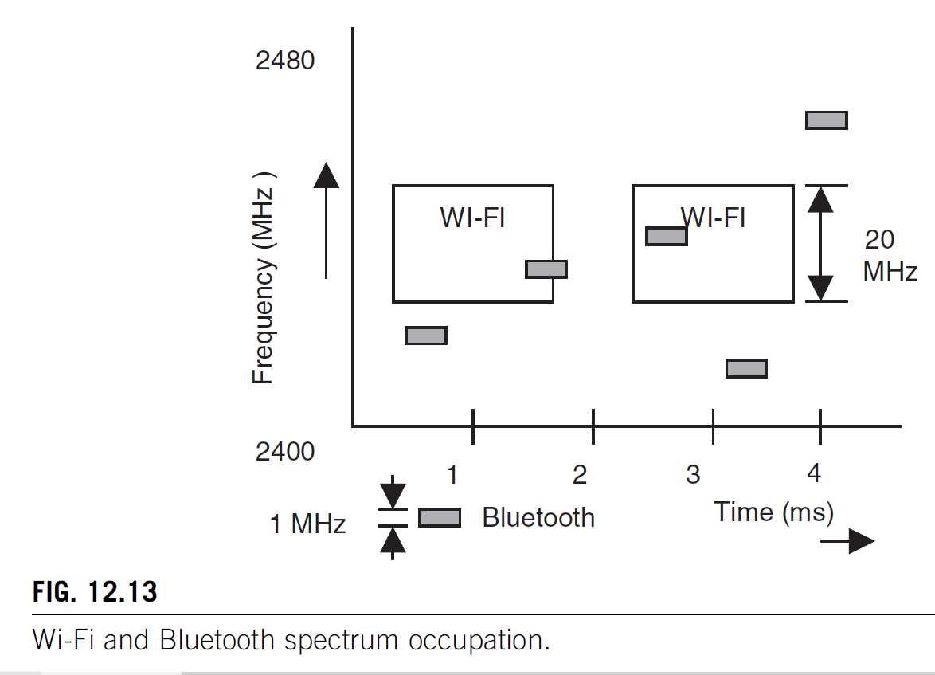
Parameters that affect interference between Bluetooth and Wi-Fi:

Slide 54
Parameters that affect interference between Bluetooth and Wi-Fi
Frequency and time overlap:
A collision occurs when the interferer transmits at the same time as the desired transmitter and is strong enough to cause a bit or symbol error in the received packet.
Packet length:
The longer the packet length of the Wi-Fi system, relative to a constant packet length and hop rate of Bluetooth, the longer the victim may be exposed to interference from one or more collisions and the greater the probability of a packet error.
Bit rate:
Higher the bit rate, the lower the receiver sensitivity and therefore the more susceptible the victim will be to packet error for given desired and interfering signal strengths.
Higher bit rates usually result in reduced packet length, with the opposite effect.
:

Slide 55
Parameters that affect interference between Bluetooth and Wi-Fi
Use factor:
More often the interferer transmits, the higher the probability of packet error.
When both communicating terminals of the interferer are in the interfering vicinity of the victim, the use factor is higher than if the terminals are further apart and one of them does not have adequate strength to interfere with the victim.
• Relative distances and powers:
The received power depends on the power of the transmitter and its distance.
Generally, Wi-Fi systems use more power than Bluetooth, typically 20 mW compared to 1 mW.
Bluetooth Class 1 systems may transmit up to 100 mW, but their output is controlled to have only enough power to give a required signal level at the receiving terminal.
•
:

Slide 56
Parameters that affect interference between Bluetooth and Wi-Fi
Signal-to-interference ratio of the victim receiver, SIR, for a specified symbol or frame error ratio.
Type of modulation, and whether error-correction coding is used.

Slide 57

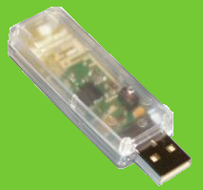

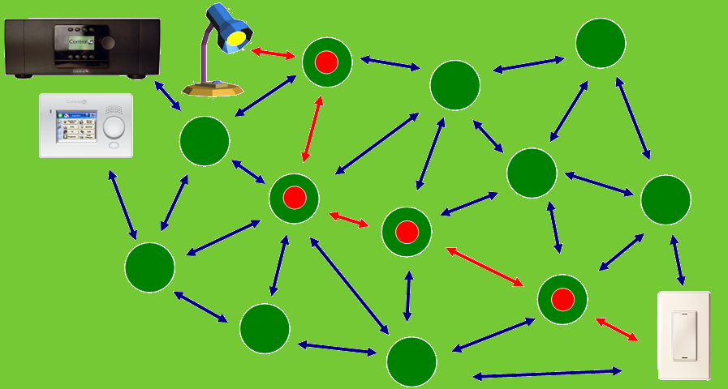
ZigBee
High-level communication protocol
The Name
Zig-zagging of bees from flower to flower
Analogous to mesh networking
https://youtu.be/QXV_HgGO--g?si=-YOB-22gOHflQv2B

Slide 58
Zigbee
IEEE specification 802.15.4 associated with Zigbee, but it should be seen as a separate entity.
Low data rate WPAN which describes the physical and data link layers that typically address remote monitoring and control applications.
An association of committed companies, the Zigbee Alliance, has defined the network, security, and application layers above the 802.15.4 physical and medium access control (MAC) layers, and deals with interoperability certification and testing

Slide 59
Distinguishing features are:
Low data rates—raw rates between 20 and 250 kbps
Low power consumption—several months up to two years on standard primary batteries
Network topology appropriate for multisensor monitoring and control applications
Low complexity for low cost and ease of use
Very high reliability and security

Slide 60
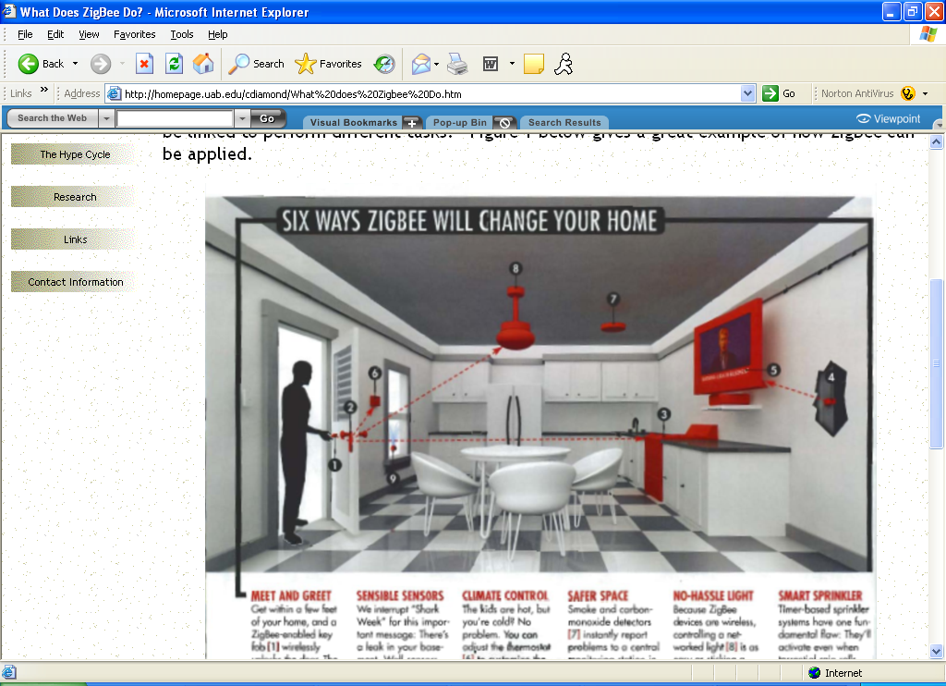
Zigbee
Applications:
consumer electronics
Home and building automation
Security systems
Industrial controls
PC peripherals
Medical and Industrial sensor applications
Toys and games
Source: http://www.zigbee.org/imwp/idms/popups/pop_download.asp?ContentID=7092

Slide 61

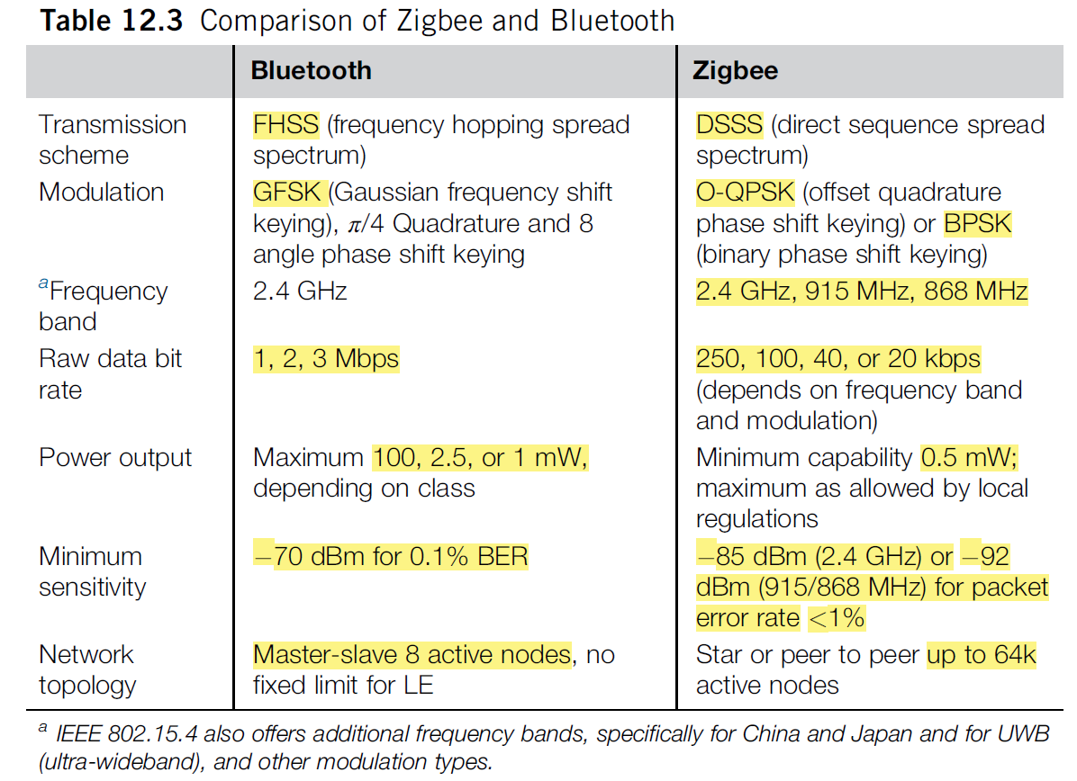

Slide 62
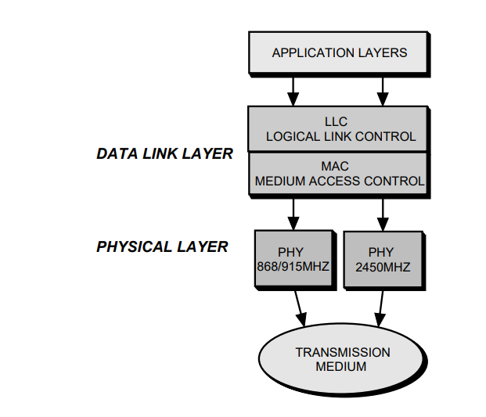
Zigbee Architecture

Slide 63
Zigbee Architecture
Similar to that of other IEEE standards, Wi-Fi and Bluetooth
On the bottom are the physical layers, showing two alternative options for the RF transceiver functions of the specification.
Both of these options are not expected to exist in a single device, and indeed their transmission characteristics—frequencies, data rates, modulation system—are quite different.
Embedded firmware and software layers above them will be essentially the same no matter what physical layer is applied.
Just above the physical layers (PHY) is the MAC layer which is responsible for management of the physical layer and delivering data to and from the applications through the layer above it.
MAC layer functions →channel access, keeping track of slot times, and message delivery acknowledgement.
The higher layers are not part of IEEE 802.15.4.

Slide 64
Zigbee Architecture
Functions of the network layer →forming a network, managing association with the network and disassociation from it, and routing.
Its functions and the application services above it are defined by the Zigbee Alliance.
Application software is not a part of the IEEE 802.15.4 specification.
Zigbee Alliance prepares profiles, or programming guidelines and requirements for various functional classes in order to assure product interoperability and vendor independence.
These profiles define network formation, security, and application requirements while keeping in mind the basic Zigbee features of low power and high reliability.

Slide 65
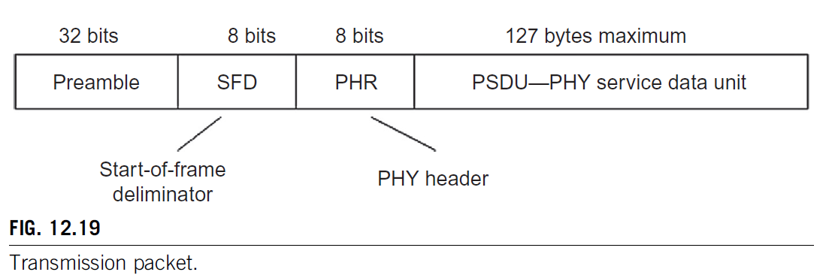
Zigbee Frame structure
Purpose of the preamble →permit acquisition of chip and symbol timing.
PHY header, PHR, which is signaled by a delimiter byte SFD (Start-of-frame deliminator), notifies the baseband software in the receiver of the length of the subsequent data.
PSDU (PHY service data unit) is the message that has been passed down through the higher protocol layers.
Can have a maximum of 127 bytes although monitoring and control applications will typically be much shorter.
Each of the new coded bits is called a chip. The complete group of chips representing a data bit is called a symbol

Slide 66
Zigbee Frame structure
Included in the PSDU are information on the format of the message frame, a sequence number, address information, the data payload itself, and at the end, two bytes that serve as a frame check sequence.
Reliability is assured since the receiver performs an independent calculation of this frame check sequence and compares it with the value received.
If any bits have been changed by interference or noise, the numbers will not match.
Only when a match occurs, the receiving side returns an acknowledgement to the originator of the message.
Lacking an acknowledgement, the transmission will be repeated until it is successfully received.

Slide 67
Zigbee Frame structure
In order to avoid two or more stations trying to transmit at the same time, a carrier sense multiple access with collision avoidance (CSMA-CA) routine is employed, similar to that used in Wi-Fi, IEEE 802.11.
The 802.15.4 receiver monitors the channel and if it is idle it may initiate a transmission. If the channel is occupied, the terminal must wait a random back off period before it can again attempt access.
Acknowledgement messages are sent without using the collision avoidance mechanism.

Slide 68
Zigbee Applications
Promoters of Zigbee aim to cover a very large market for those applications that require relatively low data rates.
Open specification and a recognized certification of conformity are an advantage in many situations.
Eg. home burglar alarm system
Use of devices approved according to a recognized standard gives the consumer some security against obsolescence.
Although Zigbee claims to be appropriate for most control applications, its declared maximum range of some 50–75m will fall short of the requirements of many systems.
Under the constraint of low power output for low power consumption, greater range means reduced bandwidth and reduced data rate.
In fact, a great many of the applications envisaged by Zigbee can get by very well with data rates of hundreds or a few thousand bits per second, and by matching receiver bandwidth to these rates for maximum sensitivity, ranges of hundreds of meters can be achieved.

Slide 69
Zigbee Applications and conflicts
One partial answer to the range question is the deployment of the Zigbee network in a cluster-tree configuration.
Adjacent nodes serve as repeaters so that large areas can be covered, as long as the greatest distance between any two directly communicating nodes does not exceed IEEE 802.15.4 basic range capability.
For Eg, in a multi-floor building, sensors on the top floor can send alarms to the control box in the basement by passing messages through sensors located on every floor and operating as relay stations.
There is competition between Bluetooth and Zigbee for use in certain applications, but the overall extent of deployment and the reliability of wireless control systems are higher because of it.
The proportion of wireless security and automation systems has increased because adherence to the 802.15.4 standard provides high reliability, security, and reduced development costs compared to many proprietary solutions.

Slide 70
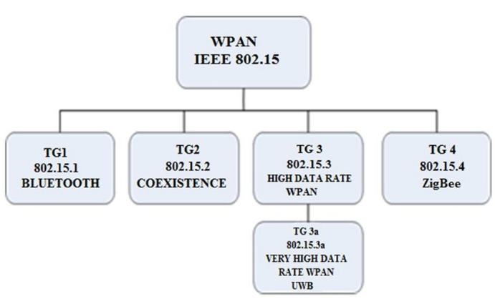
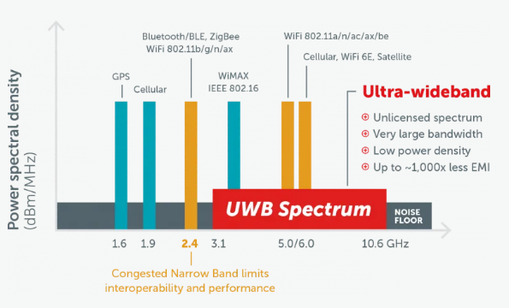

Slide 71

Ultra-wideband Technology
Ultra-wideband Technology:
Ultra-wideband (UWB) technology is based on transmission of very narrow electromagnetic pulses at a low repetition rate.
Creates a radio spectrum that is spread over a very wide bandwidth—much wider than the bandwidth used in the spread-spectrum systems.
UWB transmissions are virtually undetectable by ordinary radio receivers and therefore can exist concurrently with existing wireless communications without demanding additional spectrum or exclusive frequency bands.
https://youtu.be/pE-WbKLMElI?si=7xsJpiM1_hoWKySN

Slide 72
Advantages of UWB technology:
Very low spectral density—Very low probability of interference with other radio signals over its wide bandwidth
High immunity to interference from other radio systems
Low probability of interception/detection by other than the desired communication link terminals
High multipath immunity
Many high data rate ultra-wideband channels can operate concurrently
Fine range-resolution capability
Relatively simple, low-cost construction, based on nearly all digital architectures.

Slide 73
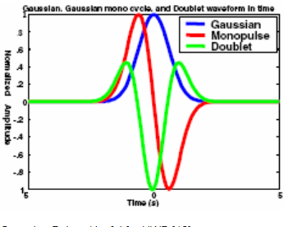
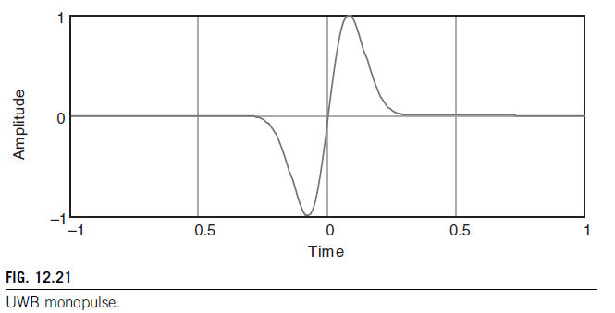
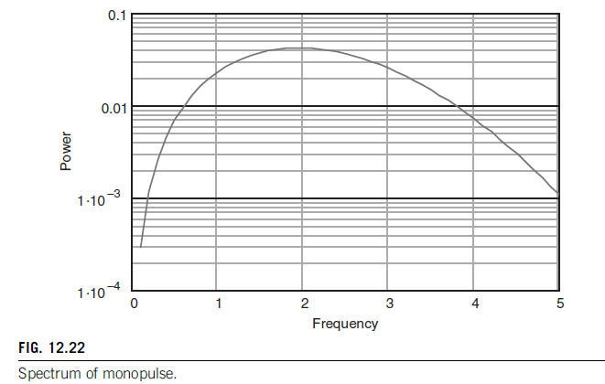
Ultra-wideband Technology
Transmission and reception methods are unique
UWB “carrier” is a Gaussian monopulse
Applications
Air tags → get accurate location
Smart car access
Wearable health sensors
Wireless printers to contactless payments

Slide 74
Ultra-wideband Technology- Bit Sequence detection
A “1” monopulse is represented by a negative line followed by a positive line, and a “0” monopulse by the inverse—a positive line and a negative line.
The synchronized sequence generated in the receiver is drawn on the second line and below it the result of the correlation operation
∫f(t)g(t)dt
where f(t) is the received signal and g(t) is the locally generated sequence.
By sampling this output at the end of each bit period and then resetting the correlator, the transmitted sequence is reconstructed in the receiver.
This is shown as the “Logic Output” which is delayed by one symbol period.

Slide 75
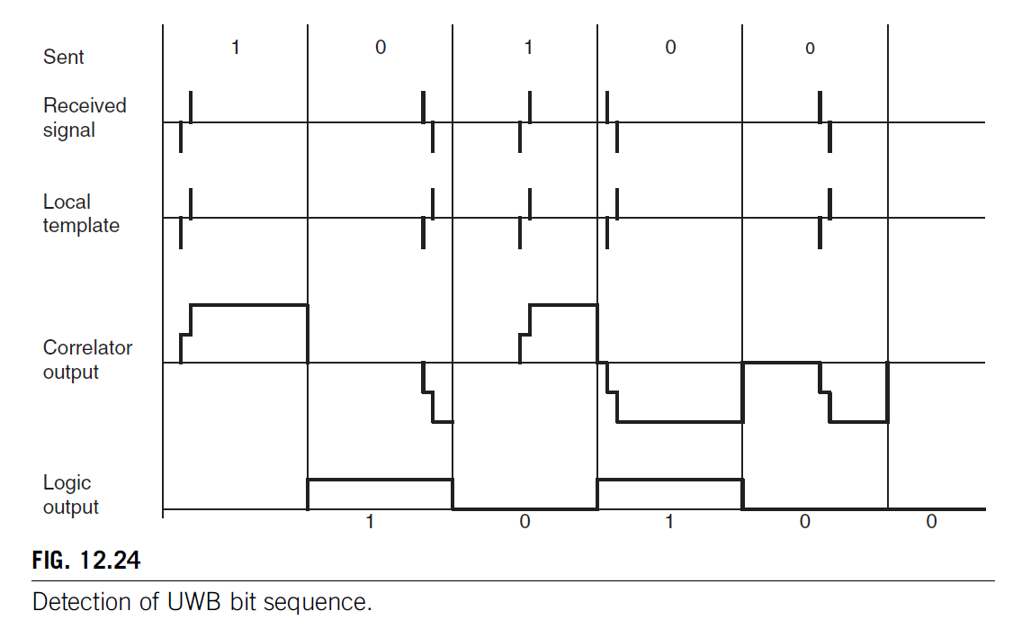
Ultra-wideband Technology- Bit Sequence detection
Individual bit can be represented by more than one sequential monopulse.
Doing so increases the processing gain by the number of monopulses per bit.

Slide 76
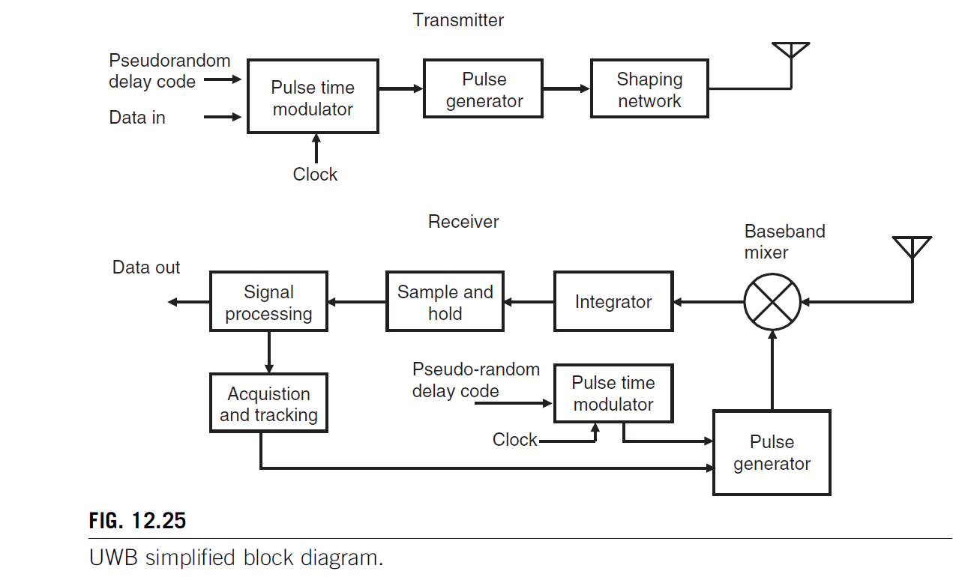
Ultra-wideband block diagram

Slide 77
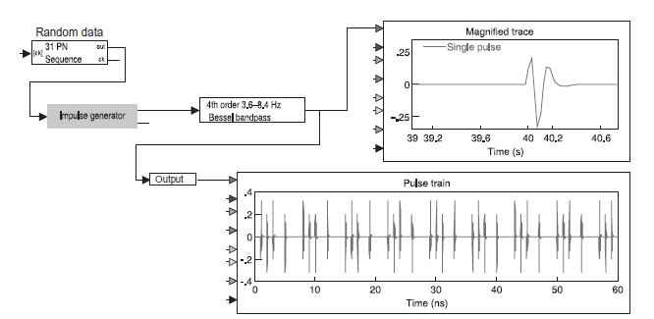
Ultra-wideband block diagram
The pulse generator block creates short impulse or step functions with rise times on the order of tens or at the most hundreds of picoseconds which are conditioned in the shaping network to produce the required output spectrum.
High speed integrated circuits or special circuit elements such as tunnel diodes or step recovery diodes, can be employed in the pulse generator.
The receiver produces a replica of the known transmitted pulse sequence which is synchronized with the incoming pulse stream in the acquisition and tracking block.
The baseband mixer (multiplier), integrator and sample and hold blocks perform the correlation function and data are output

Slide 78
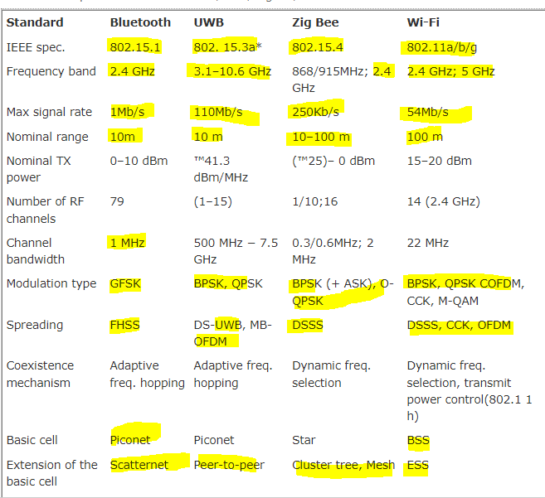
Comparison between various short range wireless technologies

Slide 79


